Slide 1
Cryptography

Slide 2
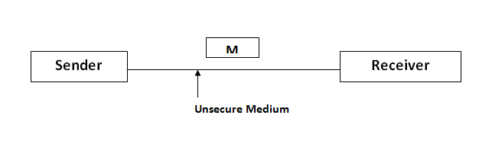
Network Security
Message on unsecure channel the confidentiality of the message may be breach

Slide 3
Cryptography
Cryptography is the study of secure communications techniques that allow only the sender and intended recipient of a message to view its contents. The term is derived from the Greek word kryptos, which means hidden.
Confidentiality may be achieved through cryptography.

Slide 4
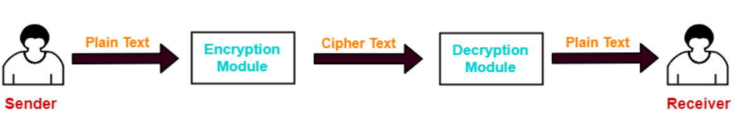
Cryptography
The message exchange using cryptography involves the following steps
Step 1:
At sender side, Using an encryption algorithm, the message is converted into an unreadable form. The message in unreadable form is called as cipher text.
cipher text - the coded message

Slide 5
Cryptography
Step 2:
The cipher text is sent to the receiver over the communication channel. Since the message is encrypted, the attackers can not read the message.

Slide 6
Cryptography
Step 3:
At receiver side, Using a decryption algorithm, the message is again converted into the readable form. Then, receiver can read the message.

Slide 7
Cryptography Techniques
Cryptography techniques may be classified as:
Symmetric Key Cryptography
Asymmetric Key Cryptography

Slide 8
Symmetric Key Cryptography
Symmetric Key Cryptography:
Both sender and receiver uses a common key to encrypt and decrypt the message.
This secret key is known only to the sender and to the receiver.
It is also called as secret key cryptography.

Slide 9
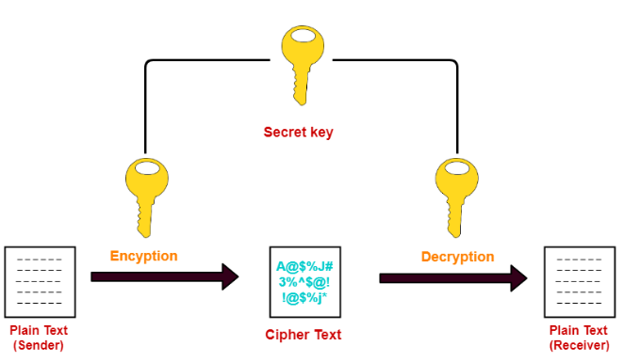
Symmetric Key Cryptography
The message exchange using symmetric key cryptography:
Before starting the communication, sender
and receiver shares the secret key.
This secret key is shared through some
external means.
At sender side, sender encrypts the message
using his copy of the key.
The cipher text is then sent to the receiver
over the communication channel.
At receiver side, receiver decrypts the cipher
text using his copy of the key.
After decryption, the message converts back
into readable format.

Slide 10
Symmetric Key Cryptography
Symmetric Encryption Algorithms:
Data Encryption Standard (DES)[56 bits]
3 Data Encryption Standard (DES)[156 Bits]
Advanced Encryption Standard (AES)[128 bits,192 bits,256 bits]

Slide 11
Symmetric Key Cryptography
Issues of symmetric key cryptography:
Sharing the secret key between the sender and receiver is an important issue.
While sharing the key, attackers might intrude.

Slide 12
Symmetric Key Cryptography
To overcome this disadvantage, Diffie Hellman Key Exchange Algorithm is used for exchanging the secret key.
Advantages: The advantages of symmetric key algorithms are
They are efficient.
They take less time to encrypt and decrypt the message.
Disadvantages:
The number of keys required is very large.

Slide 13


Symmetric Key Cryptography
Keys required in Symmetric Key Cryptography:
In case of symmetric key algorithm, each pair of users require a unique common secret key.
Cipher tex
Plain text
User 1
User 2

Slide 14
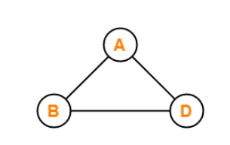

Symmetric Key Cryptography
Keys required in Symmetric Key Cryptography:
If 3 people in the world wants to use this technique, then there needs to be 3 secret keys.

Slide 15
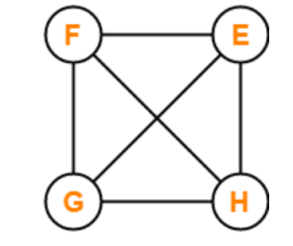
Symmetric Key Cryptography
Keys required in Symmetric Key Cryptography:
If 4 people in the world wants to use this technique, then there needs to be 6 secret keys.

Slide 16
Symmetric Key Cryptography
Keys required in Symmetric Key Cryptography:
If N people in the world wants to use this technique, then there needs to be N(N-1) / 2 secret keys.
How N(N-1)/2 Keys Will Be Required?
Consider a complete graph with N nodes.
Consider each node represents one person.
Then, each person will require (N-1) keys to communicate with other (N-1) people.
Thus, each edge must have a unique key for communication.
Thus, Number of keys required = Number of edges = ^{n}C₂ = n(n-1)/2.

Slide 17
Asymmetric Cryptography

Slide 18
Asymmetric Key or Public Key Cryptography
Asymmetric Key Cryptography:.
Sender and receiver use two different keys to encrypt and decrypt the message.
Each user use public and private key in order to encrypt and decrypt the message.

Slide 19
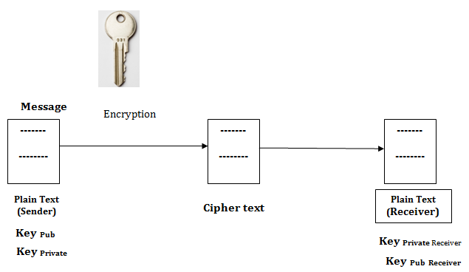
Asymmetric Key or Public Key Cryptography
Let there are sender and receiver, sender want to send the message over unsecure channel using asymmetric key cryptography.
Using sender public key
Using sender private key
Using receiver private key
Using receiver public key

Slide 20
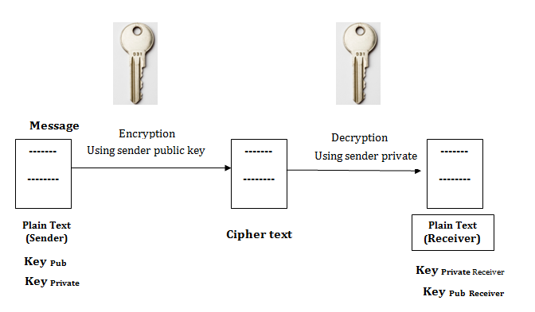
Asymmetric Key or Public Key Cryptography
Using sender public key: Sender encrypt the message using it’s public key and receiver require private key of the sender to decrypt the message.
[Sender not encrypt the msg with sender public key]

Slide 21
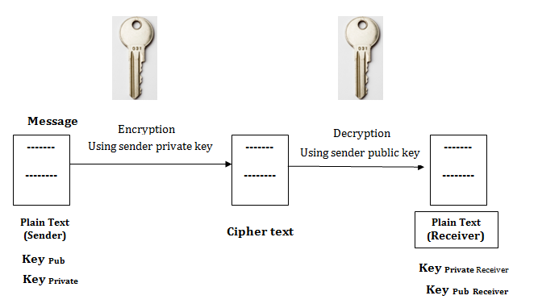
Asymmetric Key or Public Key Cryptography
Using sender private key: Sender encrypt the message using it’s private key and receiver require public key of the sender to decrypt the message.
[Sender not encrypt the msg with sender private key]

Slide 22
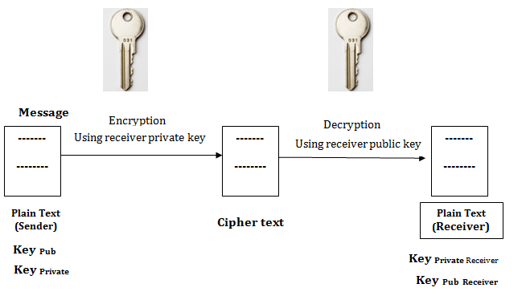
Asymmetric Key or Public Key Cryptography
Using receiver private key: Sender encrypt the message using receiver’s private key and receiver require public key of the receiver to decrypt the message.
[Receiver will not share its private key to sender ]

Slide 23
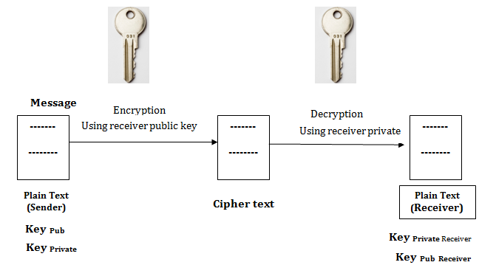
Asymmetric Key or Public Key Cryptography
Using receiver public key: Sender encrypt the message using receiver’s public key and receiver require private key of the receiver to decrypt the message.
[Valid case]

Slide 24
Asymmetric Key or Public Key Cryptography
Advantages:
It is more robust.
It is less susceptible to third-party security breach attempts.
Disadvantages:
It involves high computational requirements.
It is slower than symmetric key cryptography.

Slide 25
Asymmetric Key or Public Key Cryptography
Number of Keys Required:
Each individual requires two keys- one public key and one private key.
For n individuals to communicate, number of keys required = 2 x n = 2n keys.

Slide 26
Asymmetric Key or Public Key Cryptography
Asymmetric Encryption Algorithms:.
The famous asymmetric encryption algorithms are
RSA Algorithm
Diffie-Hellman Key Exchange

Slide 27
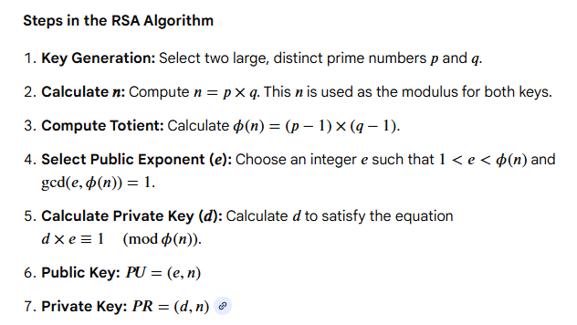
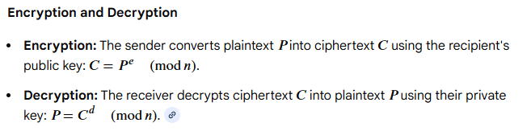
RSA Algorithm
The RSA (Rivest-Shamir-Adleman) algorithm is a asymmetric/public cryptographic method, introduced in 1978, that uses a public key for encryption and a private key for decryption.
Ron Rivest,
Adi Shamir
Leonard Adleman

Slide 28
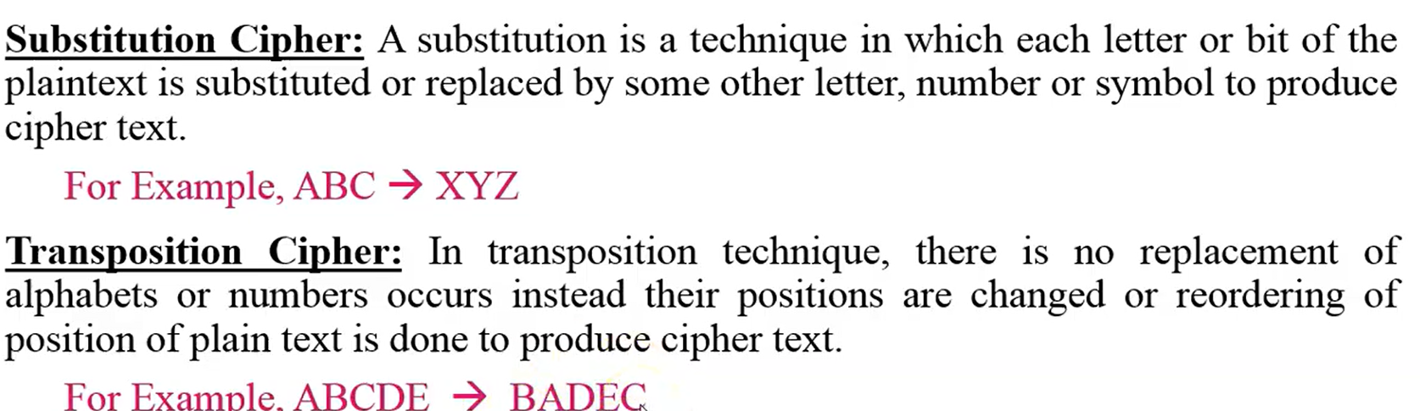
Classical Encryption Techniques
There are two basic encryption techniques:
1. Substitution
2. Transposition

Slide 29
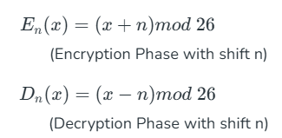
Caesar Cipher Encryption Techniques
The Caesar cipher is a simple encryption technique that was used by Julius Caesar to send secret messages to his allies. It works by shifting the letters in the plaintext message by a certain number of positions, known as the "shift" or "key". The Caesar Cipher technique is one of the earliest and simplest methods of encryption techniques.

Slide 30
SECURE HASH ALGORITHM (SHA)
In recent years, the most widely used hash function has been the Secure Hash Algorithm (SHA).
• SHA was developed by the National Institute of Standards and Technology (NIST) and published as a federal information processing standard (FIPS 180) in 1993. When weaknesses were discovered in SHA, now known as SHA-0, a revised version was issued as FIPS 180-1 in 1995 and is referred to as SHA-1.
• The actual standards document is entitled “Secure Hash Standard.” SHA is based on the hash function MD4, and its design closely models MD4. SHA-1 is also specified in RFC 3174, which essentially duplicates the material in FIPS 180-1 but adds a C code implementation.

Slide 31
SECURE HASH ALGORITHM (SHA)
SHA-1 produces a hash value of 160 bits. In 2002, NIST produced a revised version of the standard, FIPS 180-2, that defined three new versions of SHA, with hash value lengths of 256, 384, and 512 bits, known as SHA-256, SHA-384, and SHA-512, respectively. Collectively, these hash algorithms are known as SHA-2
• The algorithm takes as input a message with a maximum length of less than 2128 bits and produces as output a 512-bit message digest. The input is processed in 1024-bit blocks.

Slide 32
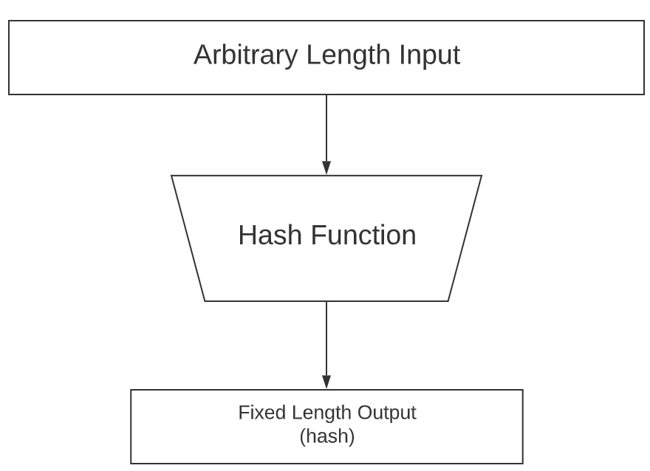
SHA−512 (Secure Hash Algorithm 512-bit)
Message Lenght
SHA 512
Hash Value =512 bit

Slide 33
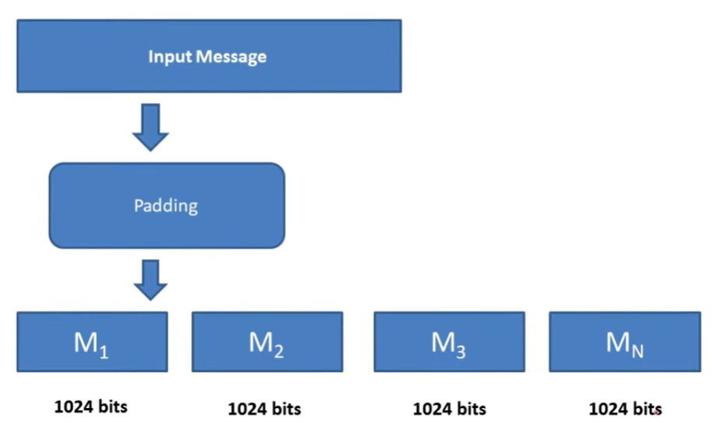
How SHA−512 generate 512 bit Digest
24 bit
Add 1 or 0 pattern
N * 1024

Slide 34
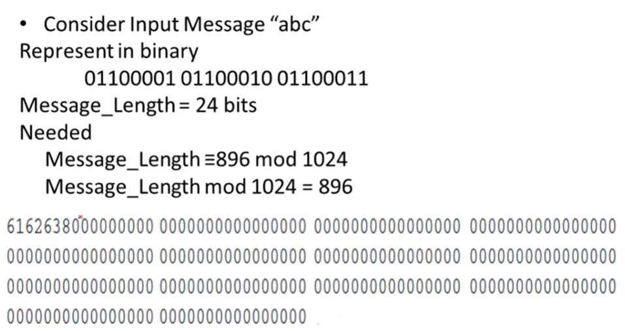
Padding Example
The algorithm takes as input a message with a maximum length of less than 2^128 bits and produces as output a 512-bit message digest. The input is processed in 1024-bit blocks.
Hexadecimal Representation

Slide 35
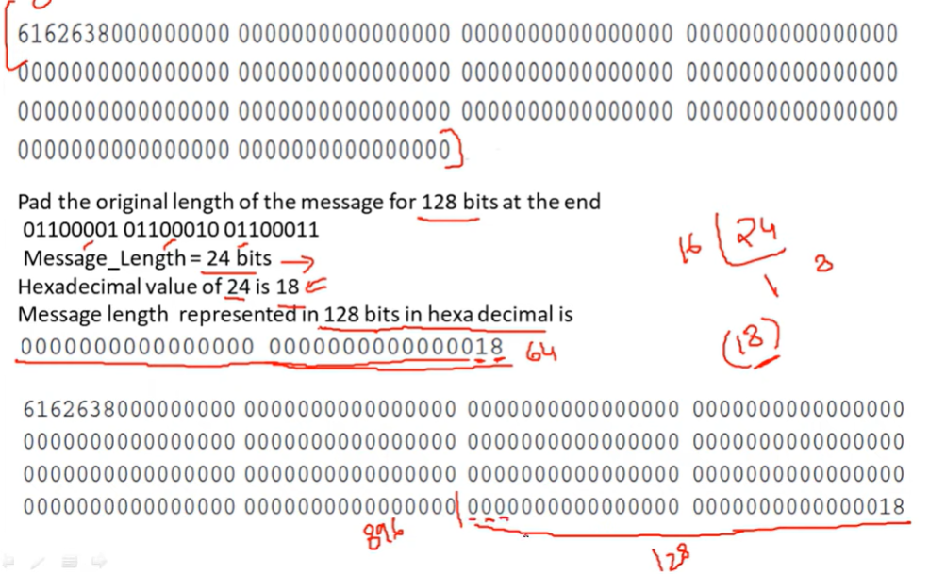
Padding Example

Slide 36
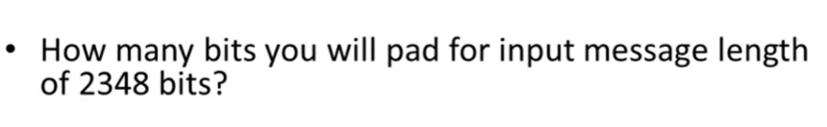
Padding Example

Slide 37
Digital Signature
Digital Signature
A digital signature is a cryptographic technique used to verify the authenticity, integrity, and non-repudiation of a digital message or document. It ensures that the message was created by a known sender and that it has not been altered during transmission.

Slide 38
Digital Signature
Authentication: Authentication is a technique that confirms a user's identity before allowing them access to a system. Authentication aids in the authentication of message sources in digital signatures.
Non-repudiation: The term "non-repudiation" refers to guaranteeing something that cannot be disputed. It assures that someone who signs a contract or communicates with someone else cannot subsequently deny the legitimacy of their signature on a document or in a file or the transmission of a message that they initiated.
Integrity: Integrity guarantees that the communication is genuine and correct and protects it against unauthorised changes during delivery.

Slide 39
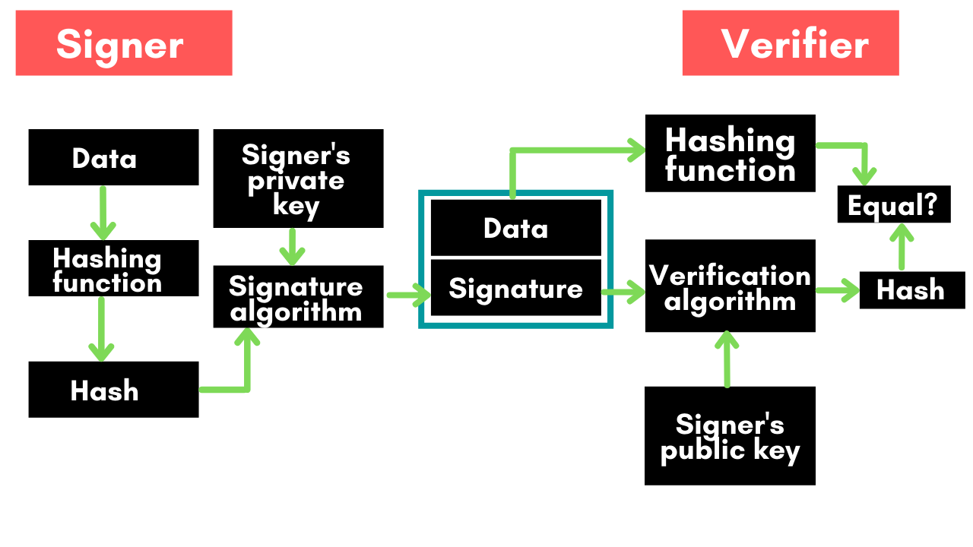
Digital Signature Model
Rivest-Shamir-Adleman (RSA)
Digital Signature Algorithm (DSA)
https://www.geeksforgeeks.org/computer-networks/digital-signature-algorithm-dsa/

Slide 40
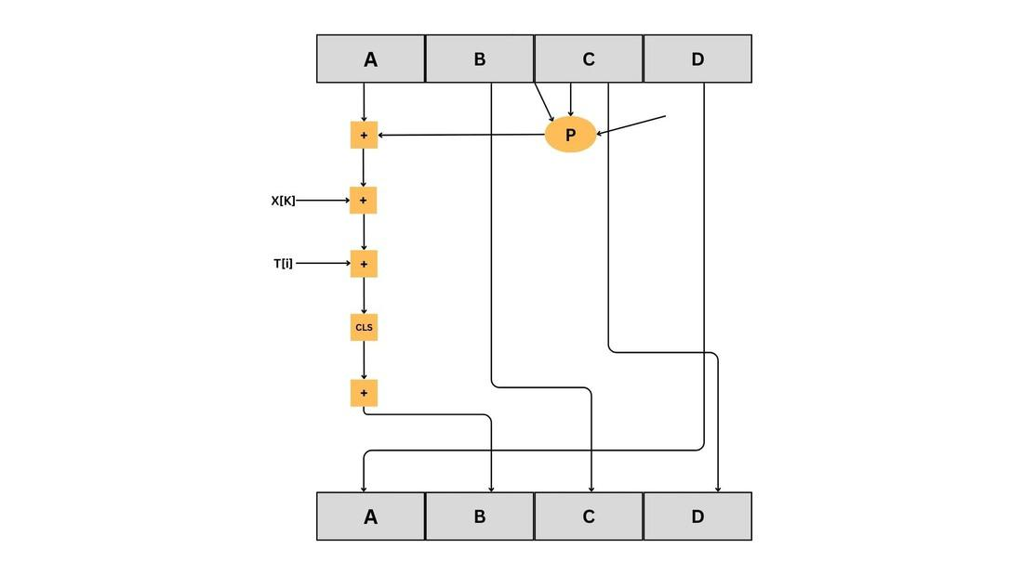
What is MD5 Algorithm?
MD5 hash algorithm is a cryptographic hash function that takes input messages and produces a fixed size 128-bit hash value irrespective of the size of the input message. MD5 was created in 1991 by Ronald Rivest to validate data integrity, detect tampering, and generate digital signatures.
MD5 Algorithm Work?
Step 1: Padding
Step2: Append Length Bits
Step 3: Block Partitioning
The padded message is separated into 512-bit blocks.
Step4. Initialize MD buffer:
Here, we use the 4 buffers i.e. A B, C, and D. The size of each buffer is 32 bits.

Slide 41
What is MD5 Algorithm?
MD5 Algorithm Work?
4. Process Each 512-bit Block:
In order to process each 512-bit Block we have performed 64.
In the 1st round, 16 operations will be performed using the function F
2nd round 16 operations will be performed using the function G
3rd round 16 operations will be performed using the function H
4th round, 16 operations will be performed using the function I
We perform OR, AND, XOR, and NOT (basically these are logic gates) for calculating functions. We use 3 buffers for each function i.e. B, C, D.

Slide 42
Transposition Cipher Technique
The Transposition Cipher Technique is an encryption method used to encrypt a message or information. This encryption method is done by playing with the position of letters of the plain text.
Types of Transposition Cipher Techniques
There are three types of transposition cipher techniques
Rail Fence Transposition Cipher/ zigzag cipher
Block (Single Columnar) Transposition Cipher
Double Columnar Transposition Cipher

Slide 43
Transposition Cipher Technique
Rail Fence Transposition Cipher: I will use some variable
L=#of characters in string
N= # of rail
K=L/2(N-1)
Where K is length of string in first and last string
L should be multiple of 2(N-1)
Each internal string of length 2*K.

Slide 44
End

